Slide 1

AWS – the proof!
Lydia Clavina George, Kamil Nowak
15 April 2020
Client confidential
NTT DATA UK
Alistair Donald MacMillan

Slide 2



Roadmap
Again Why AWS?
What we have used?
Our solution
Problems
The Future

Slide 4
The task
Deploy a .war application to AWS
Before we used vagrant to deploy
Use ansible playbooks and roles to automate.

Slide 5




What tools/services did we use
VPC
EC2
RDS
S3

Slide 6
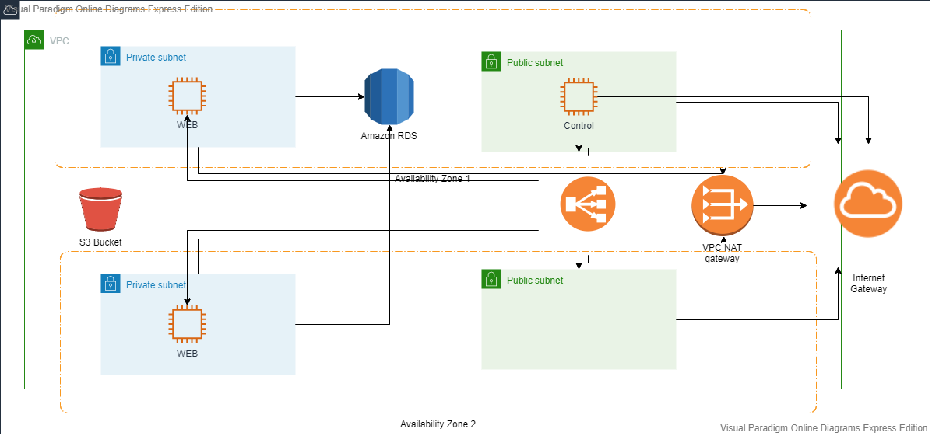
Our Solution - Architecture

Slide 7
Demo

Slide 8
Our Solution
Created EC2 instances for control and web
Assigned both public and private subnets for each instance respectively
Ensuring integrity is achieved by connecting to the web EC2’s through AWS’s available regions
Applied Load balancing features

Slide 9
What issues did we come across?
Deploy war on web server using S3
Roles/Permission issues with IAM and S3 bucket
Time constraints

Slide 10
Lydia Clavina George, Kamil Nowak
15 April 2020

